Slide 1
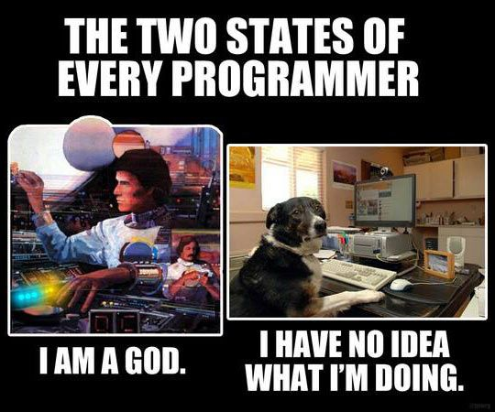
Network Visualization (DSW Session 4)
Presented by: Qing Ping

Slide 2
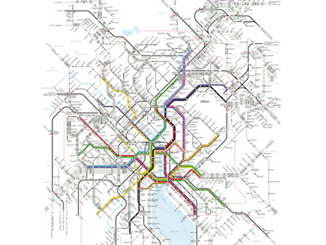
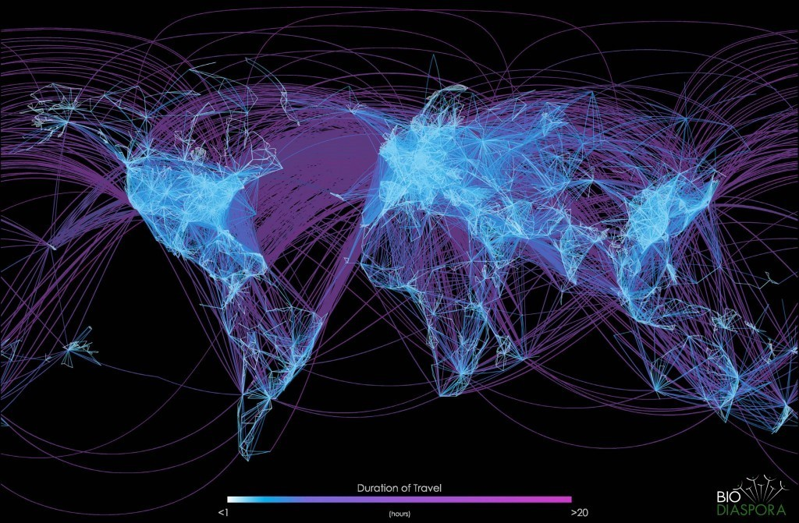
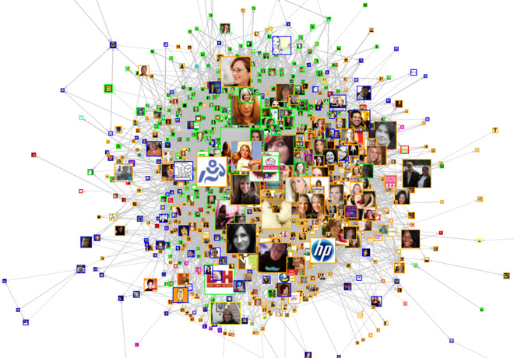
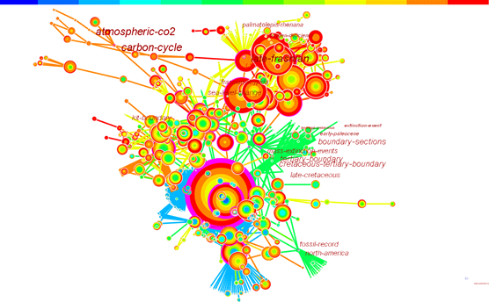
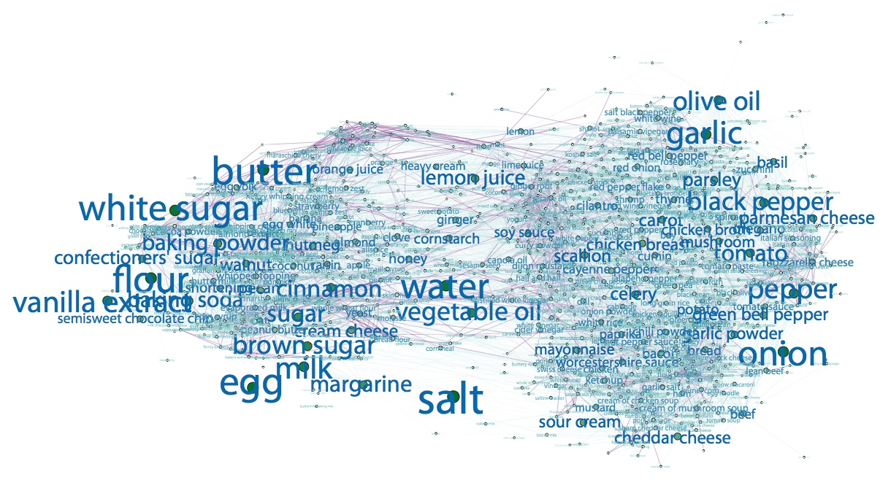
Thinking in ‘Network’
Transportation network
Airline network
Facebook friend network
Article network (intellectual space)
Ingredient network (recipe space)

Slide 3
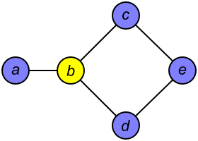
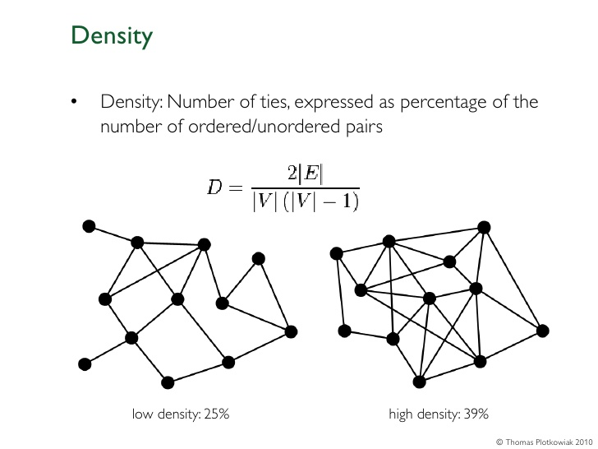
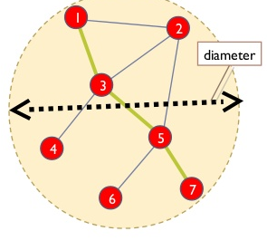
Tools for Network Analysis
Graph theory
Node
Centrality: "importance" or "influence" (in a variety of senses) of a particular node.
Edge
Betweenness: the number of shortest paths between pairs of nodes that run along it.
Distance: minimum number of ties required to connect two particular actors
Network as a whole
Density: proportion of direct ties in a network relative to the total number possible
Diameter: It is the shortest distance between the two most distant nodes in the network.

Slide 4
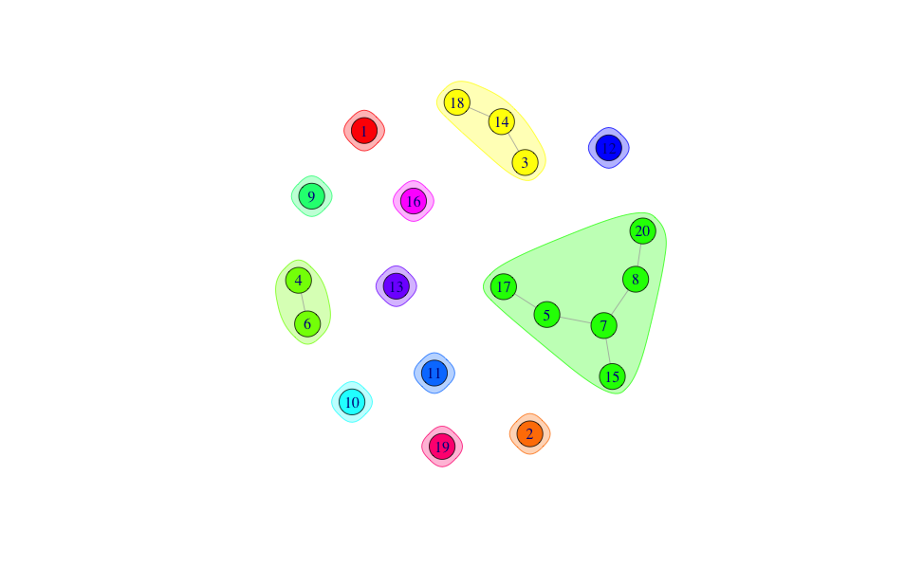
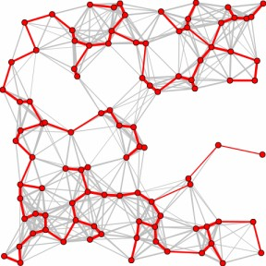
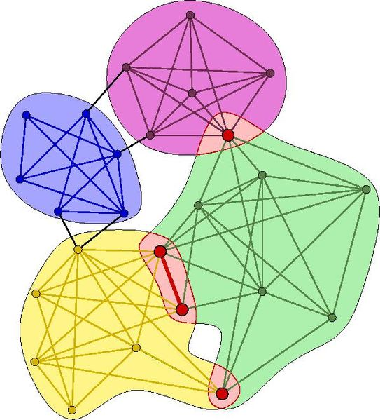
Tools for Network Analysis
Network shrinking
Connected components
Minimum Spanning Tree
Community detection
Minimum cut
Hierarchical clustering
Girvan–Newman algorithm
Modularity maximization
Statistical inference

Slide 5
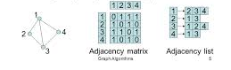
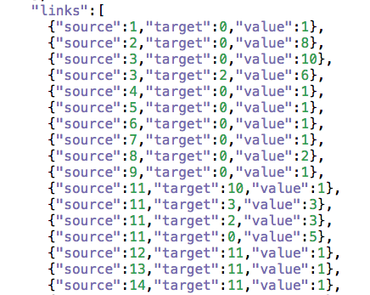
Data structure for network
Adjacent Matrix Adjacent List Node pairs

Slide 6
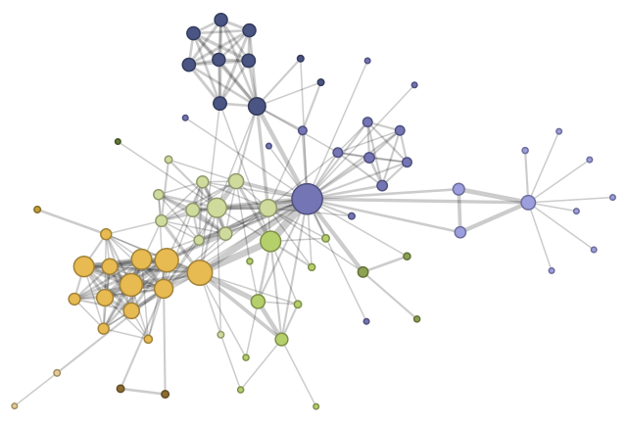
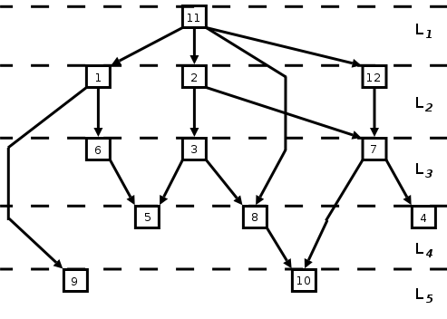
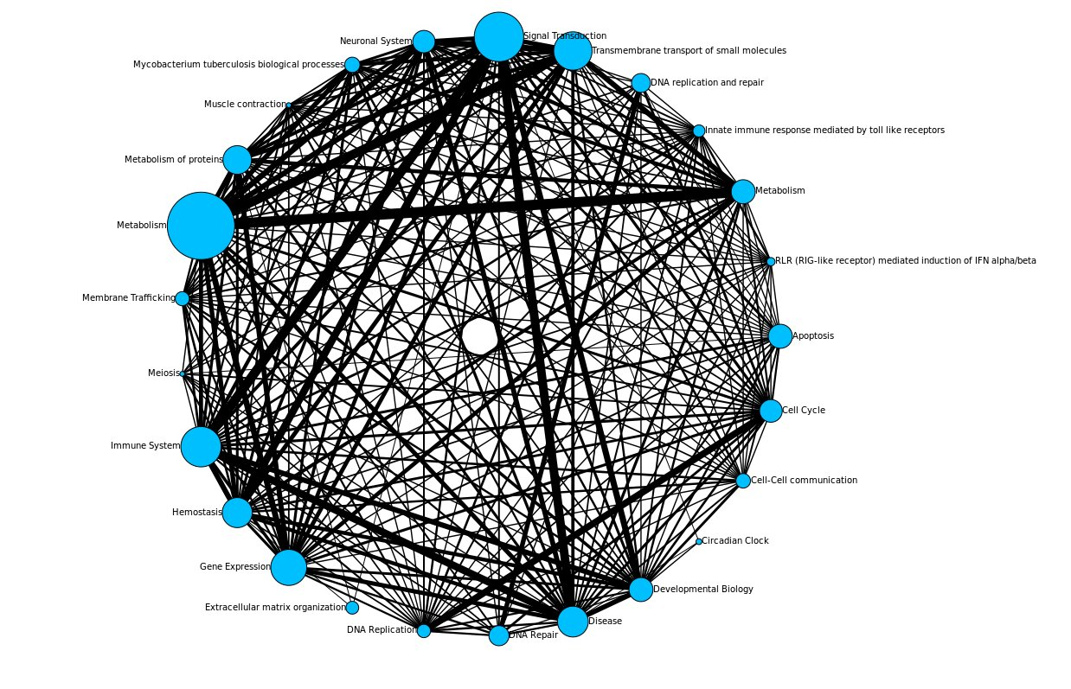
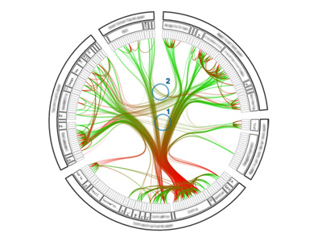

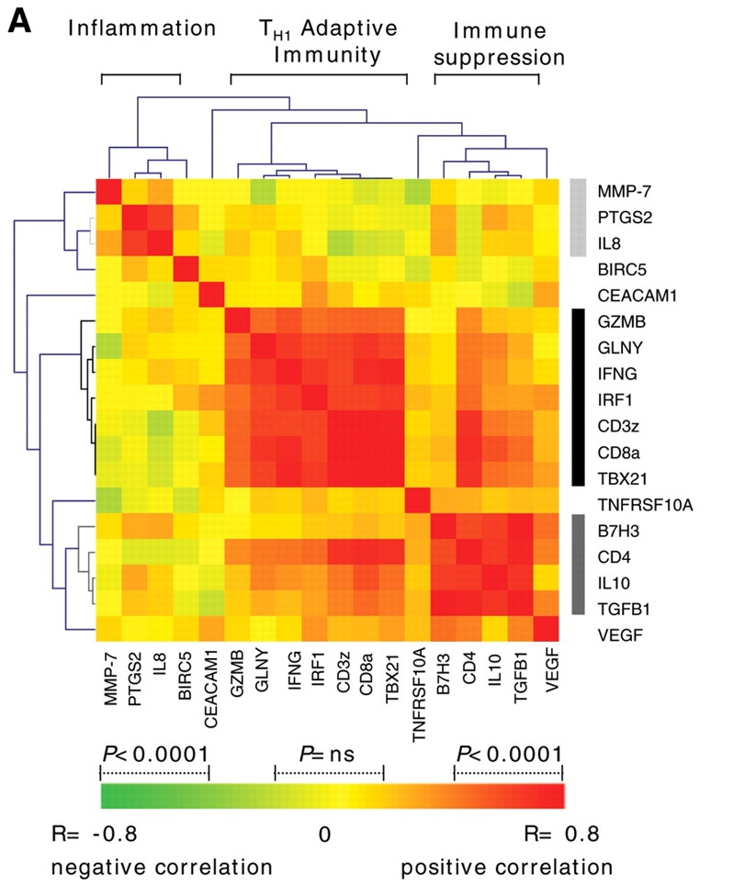
Graph layouts
Force-based layouts: edges as short as possible, nodes as apart as possible.
Layered graph drawing: vertices of a directed graph are drawn in horizontal rows or layers with the edges generally directed downwards.
Circular layout: is a style of drawing that places the vertices of a graph on a circle.
Bundled circular layout: edge bundling within the circle, together with some edges that are not bundled, drawn outside the circle
Arc diagrams: place vertices on a line; edges may be drawn as semicircles above or below the line.
Heatmap: a cross table or spreadsheet which contains colors instead of numbers, can be used to identify clusters of rows with similar values.

Slide 7
Tools for Network Visualization
D3.js
Gephi
Pajek
Sigma.js
R

Slide 8
What a [Your Animal] Likes To Eat
Write a paragraph about what your animal likes to eat. Is your animal an herbivore or a carnivore?

Slide 9
A [Your Animal’s] Early Stages of Life
Write a paragraph about what your animal is like as a baby. What is your animal called when it is a baby? How long does it stay with its mother?

Slide 10
How a [Your Animal] Survives
Write a paragraph about how your animal survives in the wild. Be sure to talk about how it adapts to its environment.

Slide 11
More Interesting Facts About [Your Animal]
Write a concluding paragraph about your animal. Include more interesting facts about your animal.

